Slide 2
Serverless in Action
Eduardo Laureano – Principal PM Lead, Azure Functions
@eduardolaureano
Jeff Hollan – Senior Program Manager, Azure Functions
@jeffhollan
BRK2132

Slide 3

Session Plan
Serverless refresher
(in case you’ve been busy in the last few years)
Serverless Practical Concepts Around:
Monitoring
Scalability
Networking
Supportability
Performance
Session Format:
Dueling Tips & Secrets !!!

Slide 4

Crash course on Serverless

Slide 5
The evolution of application platforms
On-Premises
IaaS
PaaS
Serverless

Slide 6
What is serverless?
$
Abstraction of servers
Event-driven/ instant scale
Micro-billing

Slide 7








Serverless application platform components
Development
Platform
IDE support
Functions
Logic apps
Event Grid
Integrated DevOps
Developer productivity
Visual designer
Manage all events in one place
Triggers and Bindings
100+ connectors
Near real-time delivery
Local development
Flexible deployment options
Functions orchestration
Broad coverage
Monitoring
Database
Storage
Security & Access Control
IoT
Analytics
Intelligence
Visual Debug History

Slide 8

Tips & Secrets Duel

Slide 9
#1 Easy ways to install Functions core tools

Slide 10
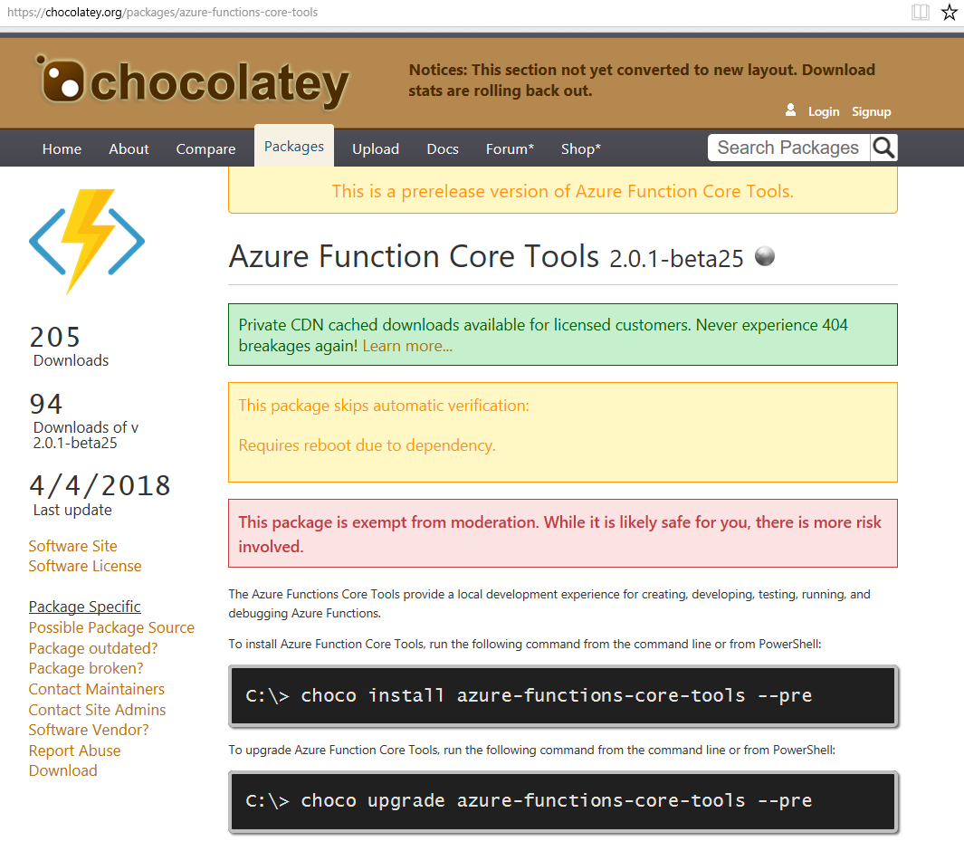
#1: Easy ways to install Functions core tools
Npm (any)
npm install –g azure-functions-core-tools@core
Brew (MacOS)
brew install azure-functions-core-tools
Aptitude (Linux)
apt-get install azure-functions-core-tools
Chocolatey (Windows)
choco install azure-functions-core-tools –pre

Slide 11
#2 Choosing the best code editor

Slide 12
#2: Choosing the best code editor
Editor | Languages | Features | Platform
Azure Portal | C# / F# (script), Node.JS | Browser-based; host compiler; automatic dependencies mgmt | Any
Visual Studio Code | C# / F# (class library), Node.JS, Java | Lightweight; tons of extensions; local debugging | Any
Visual Studio | C# / F# (class library) | Remote debugging; cloud explorer; rich project types | Windows
IntelliJ | Java | Refactoring; Smart Completion; Maven integration | Any
Note taking file editor + Functions Core Tools | C# / F# (class library), Node.JS | Minimalism; traditional-style | Any

Slide 13
#3 Simplify your code w/ triggers and bindings

Slide 14
#3: Simplify your code with triggers and bindings
Triggers – Event source that starts the function. One per function
Bindings
Input – Data that is pulled in at the start of an execution. Can have multiple
Output – Data that is pushed out after an execution. Can have multiple
Popular Triggers and Bindings
HTTP
Storage Queues
Cosmos DB
Event Hubs
Blob Storage
Service Bus Queues/Topics
Event Grid
Microsoft Graph
And more…

Slide 15
#3 Simplify your code with triggers and bindings
C# Functions – Use [Attributes()] on the function
JavaScript / C# Script (.csx) / Python – Describe in the “function.json”
Java – use @Attributes() no the function
[Blob(”path/{name}”)] string txtFile
{
“type”: “blob”,
“path”: “path/{name}”
…
@Blob(“path/{name”) String txtFile

Slide 16
#3: Simplify your code with triggers and bindings
Additional extensions for functions are available, usually with the naming convention Microsoft.Azure.WebJobs.Extensions
For example:
Microsoft.Azure.WebJobs.Extensions.CosmosDb
Microsoft.Azure.WebJobs.Extensions.EventHubs
Microsoft.Azure.WebJobs.Extensions.EventGrid
Microsoft.Azure.WebJobs.ServiceBus
…

Slide 17
#4 Leverage Environment Variables

Slide 18
#4: Leverage Environment Variables
Environment variables live on your local machines, e.g. connection strings
local.settings.json set values for local functions development
Application Settings specify environment variables for the cloud environment
Publish your local settings after deploying!
func azure functionapp publish --publish-settings-only
Application
Settings
publish
local.settings
.json
environment
variables

Slide 19
#5 Simplify your APIs w/ Functions Proxies

Slide 20

#5: Simplify your APIs w/ Functions Proxies
Proxies recap
Break down your API into multiple function apps (microservice architectures)
Routing operations scale serverlessly
Function app B
faB/products
Function2
Function app A
api/customers
Function1
api/products
External Endpoint
api/orders
ext/orders
Proxies in V2 runtime
Now available in West US 2 region, very soon worldwide

Slide 21
#6 Combine IoT + ML + Serverless

Slide 22
#6: Combine IoT + ML + Serverless
❶
❷
❸
https://microsoft.github.io/techcasestudies/iot/2016/12/19/FagorEderlan.html

Slide 23
#6: Combine IoT + ML + Serverless
IoT is a lot about processing events
IoT is also about producing and computing events locally
Machine Learning is a lot about preparing data
Intelligence can be added to your app using several services easily
Cognitive Services
IoT Edge
IoT Hub
Stream Analytics
Event Grid

Slide 24
#7 Share resources across executions (properly)

Slide 25
#7: Share resources across executions
Azure Functions automatically adds instances as needed
A single instance can process multiple requests (over time and at once)
Leverage this by sharing certain code resources across executions (HttpClient, EventHubClient, etc.)
Azure Function Instance
Function App
Execution
Execution
Execution
Execution

Slide 26
#7: Share resources across executions
Every single execution has to instantiate and dispose of HttpClient
This is a very common anti-pattern
Will result in function running out of available sockets
http://aka.ms/antipattern
public static void MyFunction(...) {
using(var client = new HttpClient()) {
client.PostAsync(...);
}
}

Slide 27
#7: Share resources across executions
Single HttpClient instantiated once when a function is initialized
Can be re-used safely across executions (over time and in parallel)
Same pattern holds true for other state or clients shared across executions
private static HttpClient client = new HttpClient();
public static void MyFunction(...) {
client.PostAsync(...);
}

Slide 28
#8 Diagnose and resolve issues

Slide 29
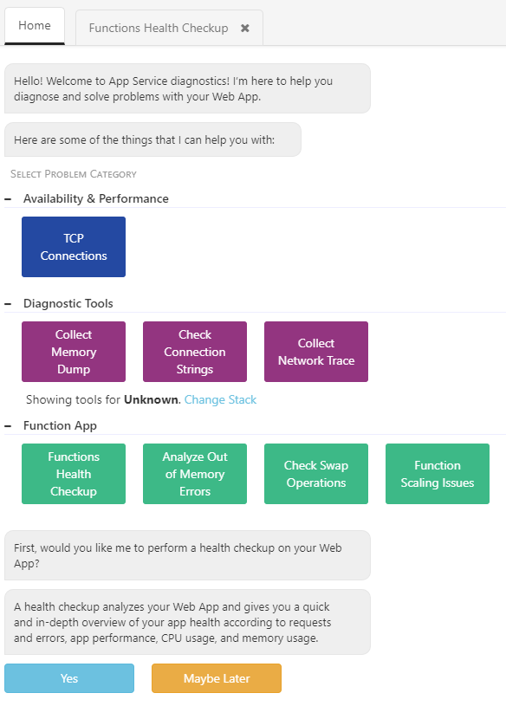
#8: Diagnose and resolve issues
In the rare occasion of something not working as expected with your functions code …
Friendly interface for guided diagnostics
Overall Functions Health Checkup
Out of Memory investigation
Scaling issues
and more …
Powered by the functions telemetry available through Application Insights

Slide 30
#9 Analyze your functions performance

Slide 31
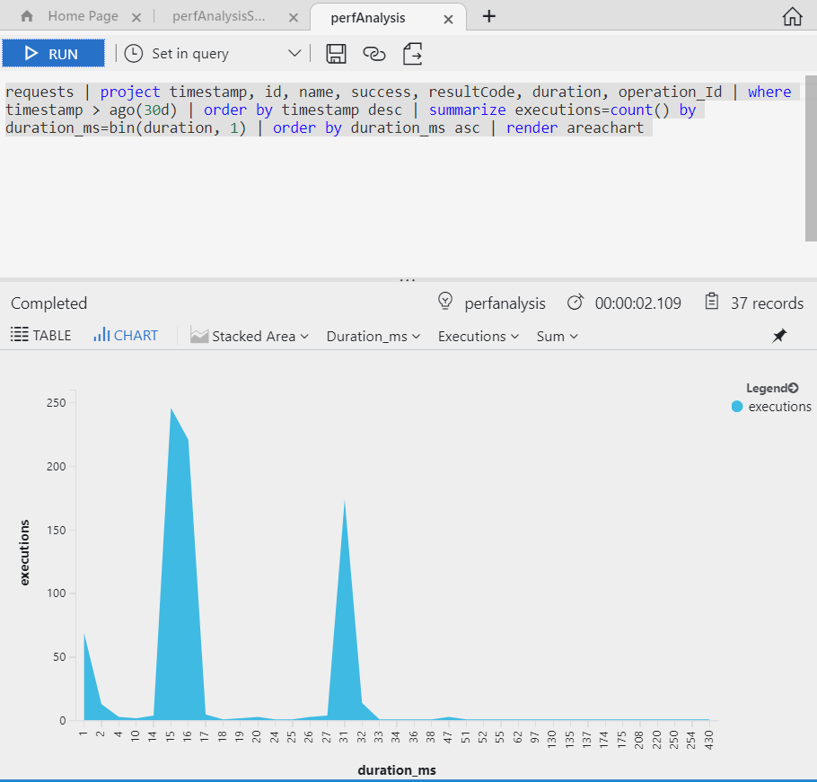
#9: Analyze your functions performance
Application Insights enabled by default
Functions Monitoring blade now powered by AI
Access to rich query language
You control how much you emit to AI
Application Insights: choosing Data Sampling Rate (retention %)
Functions: granular control by frequency, verboseness, categories or retaining aggregated telemetry

Slide 32
#10 Improving your initial startup time

Slide 33
#10: Improving your initial startup time
Cold start:
Definition: Increase in latency to execute functions which haven’t been called recently
Varies greatly on a number of factors like language and # of files.
Ways to minimize effects:
Architect your app with cold start in mind
Consider App Service plans (Dedicated mode) to keep functions warm
Reduce app dependencies
For solutions large # of files, use Run-From-Zip
Warm-up
an instance
Load code + dependencies
Code runs

Slide 34
#11 Communicating with On-Prem resources

Slide 35
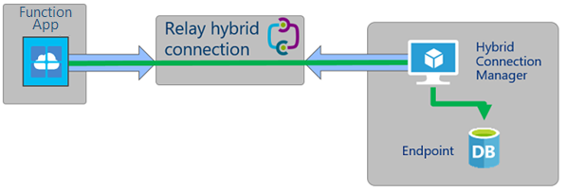
#11: Communicate with On-Prem resources
Functions running modes:
Consumption (Serverless): cannot connect to local VNET
Dedicated (App Service plan): can connect to VNET using point-to-site or Hybrid Connections
App Service Environment: function can be part of a VNET (accessed TO and FROM)
Configuring networking (portal):
Function App -> Platform features -> Networking -> VNET Integration | Hybrid Connections

Slide 36
#12 Understanding behavior at high scale

Slide 37

#12: Designing for high scale
City A
City B

Slide 38
#12: Designing for high scale
Azure Function Instance
Azure Function Instance
Function App
Azure Function Instance
Execution
Execution
Azure Function Instance
Execution
Execution
Azure Function Instance
The host.json file allows me to configure how much load each instance will have at one time

Slide 39
#13 14 Picking the right Functions runtime version

Slide 40
#14: Picking the right Functions runtime version
host process
function
code
V1 (GA):
Production workloads
C#, F#, JavaScript + experimental languages
Utilizing Proxies
V2 (Preview):
Dev Platform is not Windows
Host Platform is not Windows
C#, F#, JavaScript, Java + others coming
Node.JS
.NET
…
host
.NET Framework
language worker
process
function
code
Node.JS
Java
…
GRPC
GRPC
host process
host
.NET
.NET Core

Slide 41
Judges Deliberation

Slide 42

Takeaways
Azure Serverless is ready for you (more than ever before)
Choose the right design and tool for your needs
Try new features and report back
The platform is evolving thanks to you!
Keep asking, discussing and contributing

Slide 43
Related sessions
BRK2137 | What's new for serverless computing in Azure | Monday, May 7 2:45 PM – 4:00 PM
BRK3304 | Building event-driven Serverless Apps with Azure Functions and Azure Cosmos DB | Tuesday, May 8 10:30 AM-11:45 AM
THR2004 | Identity and secure resource access in App Service and Azure Functions | Tuesday, May 8 4:30 PM-4:50 PM
BRK2106 | Azure has your back! Keeping PaaS and Serverless apps responsive and stable | Tuesday, May 8 4:45 PM – 6:00 PM
WRK2203 | Building a serverless intelligent license plate recognition system | Tuesday, May 8 4:45 PM-6:00 PM
BRK3710 | Serverless, SPAs, and Scalability | Tuesday, May 8 4:45 PM-5:30 PM
THR3801 | Break through the serverless barriers with Durable Functions | Wednesday, May 9 11:30 AM-11:50 AM
THR3302 | Azure Functions and Microsoft Graph | Wednesday, May 9 12:30 PM-12:50 PM

Slide 44
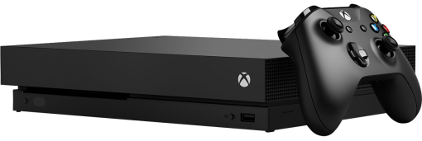
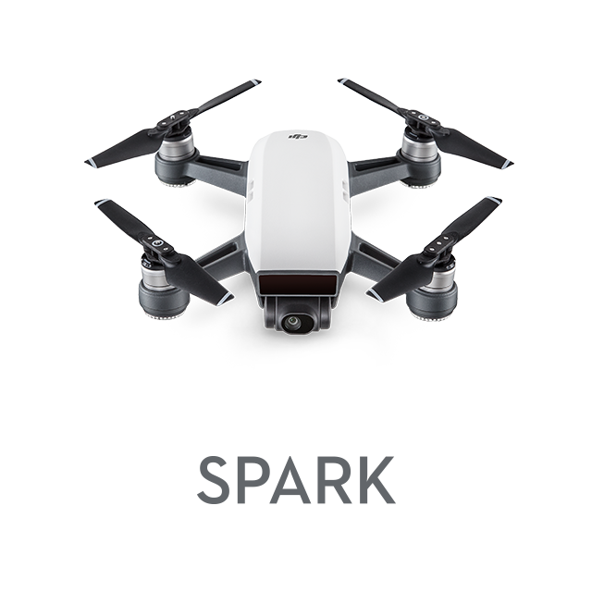

Daily Prizes
Xbox One X
DJI Spark Drone
Starbucks gift cards
Complete your evaluations to win prizes!
Be eligible to win! Make sure you are scanned into your session and complete your session eval to be eligible to win.
Seven winners each day! Winners will be notified via email.
Pick up your prize before leaving!
Prizes can be claimed at the info counter located on WSCC level 4, Galleria level.
Monday: pick up 2:15pm–6:30pm.
Tuesday: pick up 7:00am–6:00pm.
Wednesday: pick up 7:00am–5:30pm.
Please contact build@eventcore.com for more information

Slide 45
Thank you!

Slide 46
Appendix

Slide 47
#?: Leverage retry behaviors for resiliency
Coding
Queue triggers (Service Bus and Storage) have retry semantics
If an uncaught exception occurs during the execution, the message will be retried automatically
By default will retry 4 additional times, but this number can be set in the host.json file

Slide 48
Section title

Slide 49
#6: Resolving assembly loading conflicts
Coding
TBD

Slide 50
#13: Packaging your function to run anywhere
Deploy
TBD

Slide 51
#7: Obtaining a secret from KeyVault
Coding
CUT?

Slide 52
#8: Easily send data to other services (POCO)
Coding
CUT?

Slide 53
#16: Understanding Functions costs (consumption)
Tuning
Basics
GB-S

Slide 54
#12: Sync’ing local and cloud app settings
Deploy
Merged with Environment Variables

Slide 55
Software code slide
This slide layout uses Consolas, a monotype font which is ideal for showing software code.

